Slide 1
Announcements
Videos and all class material is posted in the github repository https://github.com/vipenrica/HSI. Here I will post the slides before class
I will assign one or two homework problems and one class project this year. You can always work in groups if you would like to

Slide 2
Open Channel Flow-
Review

Slide 3
Cross sectional geometry
Cross sections of river channels have complex geometries
floodplain
channel
floodplain
floodplain
floodplain
channel
channel

Slide 4
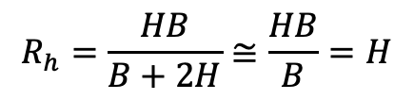

1D cross sectional geometry
Cross sections of river channels have complex geometries
floodplain
channel
floodplain
floodplain
floodplain
channel
channel
In a one-dimensional analysis these complex cross sections are approximated as rectangular with width B and depth H (cross sectionally averaged depth of the actual cross section).
B
H
$$\frac{H}{B}≪1$$
These channels are generally wide,
so that the hydraulic radius R_{h} can be approximated with the flow depth
$$R_{h}=\frac{HB}{B+2H}≅\frac{HB}{B}=H$$

Slide 5
Stage-discharge relations
Let’s ξ denote the water surface elevation (stage) and Q the water discharge.
In rivers with floodplains ξ tends to rapidly increase with Q when the flow is confined to the channel, and it increases much less rapidly when the flow spills on the floodplain.
floodplain
ξ
channel
datum

Slide 6
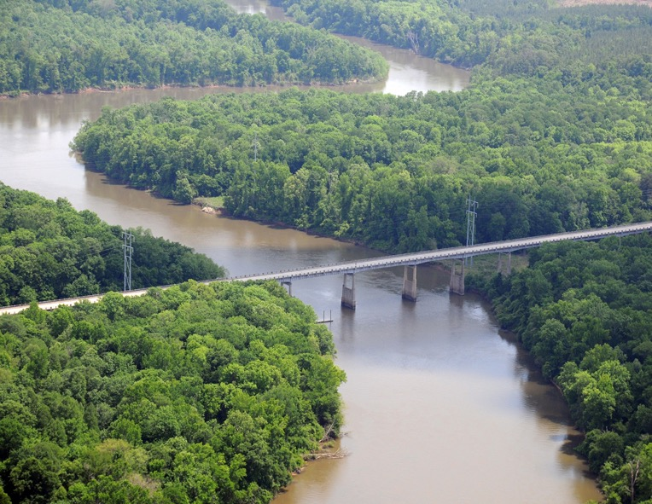
Stage-discharge relations
Let’s ξ denote the water surface elevation (stage) and Q the water discharge.
In rivers with floodplains ξ tends to rapidly increase with Q when the flow is confined to the channel, and it increases much less rapidly when the flow spills on the floodplain.
USGS (United States Geological Survey) station Congaree River at Highway 601
Rollover in the curve = bankfull discharge Q_{bf}

Slide 7
Bankfull depth and width
USGS (United States Geological Survey) station Congaree River at Highway 601
B_{bf} = 125 m
A_{bf} = 500 m²
H_{bf} = A_{bf}/B_{bf} = 4 m

Slide 8
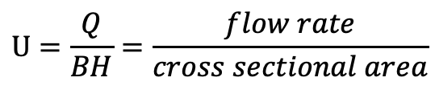
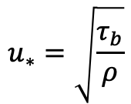
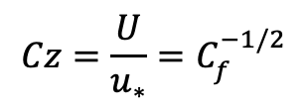

The bed shear stress (1D)
The bed shear stress τ_{b} is used to quantify sediment transport and mobility.
To quantify the bed shear stress, we need to estimate the cross-sectionally averaged flow velocity U.
$$U=\frac{Q}{BH}=\frac{flow rate}{cross sectional area}$$
The bed shear stress is computed as
$$τ_{b}=ρC_{f}U^{2}$$
where C_{f} is a non-dimensional friction coefficient that we determine with resistance relations for hydraulically rough flows or from field/lab data.
C_{f} is related to the non-dimensional Chezy resistance coefficient Cz as
$$Cz=\frac{U}{u_{∗}}=C_{f}^{−1/2}$$
$$u_{∗}=\sqrt{\frac{τ_{b}}{ρ}}$$
where u* is the shear velocity defined as

Slide 9
The unit stream power (1D)
The unit stream power ω is used to model bedload transport and sediment mobility as it quantifies the rare of loss of potential energy as water flows downhill and thus the power available for performing geomorphic flow (Ferguson 2005)
$$ω=\frac{ρgQS}{B}=\frac{water density×gravity×flow discharge×bed slope}{width}$$
Typically, the discharge used in bedload transport studies is the peak discharge
The unit stream power is widely used particularly in field studies because it is calculated from gross channel properties (width and slope), together with discharge, without needing to know within-channel flow properties such as depth and velocity

Slide 10
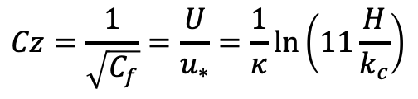
Resistance relations for hydraulically rough flow
Keulegan formulation (1938)
$$Cz=\frac{1}{\sqrt{C_{f}}}=\frac{U}{u_{∗}}=\frac{1}{κ}ln\left(11\frac{H}{k_{c}}\right)$$
where
κ = von Karman constant ~0.4
k_{c} = roughness height, i.e. a measure of the bumpiness of the bed. The subscript c denotes composite, i.e. due to more than one thing.

Slide 11
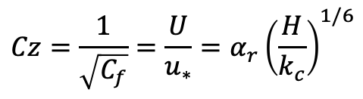
Resistance relations for hydraulically rough flow
Keulegan formulation (1938)
$$Cz=\frac{1}{\sqrt{C_{f}}}=\frac{U}{u_{∗}}=\frac{1}{κ}ln\left(11\frac{H}{k_{c}}\right)$$
where
κ = von Karman constant ~0.4
k_{c} = roughness height, i.e. a measure of the bumpiness of the bed. The subscript c denotes composite, i.e. due to more than one thing.
Manning-Strickler formulation
$$Cz=\frac{1}{\sqrt{C_{f}}}=\frac{U}{u_{∗}}=α_{r}{\left(\frac{H}{k_{c}}\right)}^{1/6}$$
α_{r} = 8 - 9
Parker (1991) found α_{r} = 8.1 for gravel bed rivers
NOTE:
Cz and C_{f} do not vary strongly with water depth H. Thus, they are often approximated as constants in calculations that do not look into the fine details of the flow, such as those that we do here.

Slide 12

Resistance relations for hydraulically rough flow
Keulegan formulation (1938)
$$Cz=\frac{1}{\sqrt{C_{f}}}=\frac{U}{u_{∗}}=\frac{1}{κ}ln\left(11\frac{H}{k_{c}}\right)$$
where
κ = von Karman constant ~0.4
k_{c} = roughness height, i.e. a measure of the bumpiness of the bed. The subscript c denotes composite, i.e. due to more than one thing.
Manning-Strickler formulation
$$Cz=\frac{1}{\sqrt{C_{f}}}=\frac{U}{u_{∗}}=α_{r}{\left(\frac{H}{k_{c}}\right)}^{1/6}$$
α_{r} = 8 - 9
Parker (1991) found α_{r} = 8.1 for gravel bed rivers
Roughness height on a plane bed is commonly expressed as a function of D₉₀ of the bed surface sediment (D_{s90})
where n_{k} = 1 – 3 and
the subscript s of k_{s} indicates that the roughness is associated with the presence of a granular bed (skin friction)
$$k_{s}=n_{k}D_{s90}$$

Slide 13
Normal (steady and uniform) flow
Normal flow refers to an equilibrium state in which the downstream pull of gravity is perfectly balanced by the resistive bed force.
The resulting flow is constant in time and does not vary in the streamwise (or flow) direction x.

Slide 14


Normal (steady and uniform) flow
Normal flow refers to an equilibrium state in which the downstream pull of gravity is perfectly balanced by the resistive bed force.
The resulting flow is constant in time and does not vary in the streamwise (or flow) direction x.
In rivers θ is generally small so that
$$sinθ≅tanθ=S \left(bed slope\right)$$
cos$θ≅1$
Δx
θ
H
B
x

Slide 15




Normal (steady and uniform) flow
Normal flow refers to an equilibrium state in which the downstream pull of gravity is perfectly balanced by the resistive bed force.
The resulting flow is constant in time and does not vary in the streamwise (or flow) direction x.
In rivers θ is generally small so that
$$sinθ≅tanθ=S \left(bed slope\right)$$
cos$θ≅1$
$$τ_{b}B∆x$$
Δx
Downstream impelling force
(component of the weight of water in the x direction)
$$ρgBH∆xS$$
Resistive bed force
$$τ_{b}B∆x$$
θ
H
$$ρgBH∆xS$$
B
x

Slide 16

Normal (steady and uniform) flow
Normal flow refers to an equilibrium state in which the downstream pull of gravity is perfectly balanced by the resistive bed force.
The resulting flow is constant in time and does not vary in the streamwise (or flow) direction x.
In rivers θ is generally small so that
$$sinθ≅tanθ=S \left(bed slope\right)$$
cos$θ≅1$
$$τ_{b}B∆x$$
Δx
Downstream impelling force
(component of the weight of water in the x direction)
$$ρgBH∆xS$$
Resistive bed force
$$τ_{b}B∆x$$
θ
H
$$ρgBH∆xS$$
Impelling force = resistive force
B
$$ρgBH∆xS=τ_{b}B∆x$$
x

Slide 17
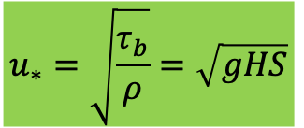

Normal (steady and uniform) flow
Normal flow refers to an equilibrium state in which the downstream pull of gravity is perfectly balanced by the resistive bed force.
The resulting flow is constant in time and does not vary in the streamwise (or flow) direction x.
In rivers θ is generally small so that
$$sinθ≅tanθ=S \left(bed slope\right)$$
cos$θ≅1$
$$τ_{b}B∆x$$
Δx
Downstream impelling force
(component of the weight of water in the x direction)
$$ρgBH∆xS$$
Resistive bed force
$$τ_{b}B∆x$$
θ
H
$$ρgBH∆xS$$
Impelling force = resistive force
B
$$ρgBH∆xS=τ_{b}B∆x$$
$$u_{∗}=\sqrt{\frac{τ_{b}}{ρ}}=\sqrt{gHS}$$
x
$$τ_{b}=ρgHS$$

Slide 18



Normal (steady and uniform) flow
The normal flow bed shear stress is equal to the product of the water depth, the bed slope, the acceleration of gravity and water density.
$$τ_{b}=ρgHS$$
On slide 7 defined the bed shear stress with a resistance relation as
$$τ_{b}=ρC_{f}U^{2}$$
We combine these two equations to derive the generalized form of the Chezy relation
$$ρC_{f}U^{2}=ρgHS$$

Slide 19

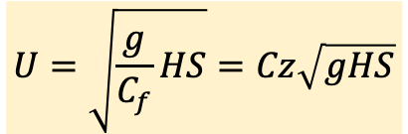
Normal (steady and uniform) flow
The normal flow bed shear stress is equal to the product of the water depth, the bed slope, the acceleration of gravity and water density.
$$τ_{b}=ρgHS$$
On slide 7 defined the bed shear stress with a resistance relation as
$$τ_{b}=ρC_{f}U^{2}$$
We combine these two equations to derive the generalized form of the Chezy relation
$$ρC_{f}U^{2}=ρgHS$$
$$Cz=C_{f}^{−1/2}$$
Recall that
$$U=\sqrt{\frac{g}{C_{f}}HS}=Cz\sqrt{gHS}$$

Slide 20
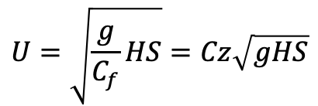
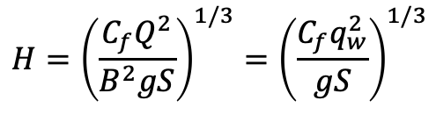
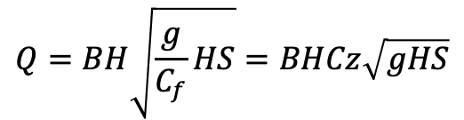
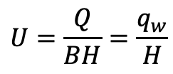

Generalized Chezy relation
$$U=\sqrt{\frac{g}{C_{f}}HS}=Cz\sqrt{gHS}$$
If we combine the generalized Chezy relation with the equation of mass conservation, we find relations linking the flow discharge Q, the bed slope S, channel width B and water depth H.
The equation of mass conservation takes the form
$$Q=UBH=q_{w}B$$
or
$$U=\frac{Q}{BH}=\frac{q_{w}}{H}$$
with q_{w} denoting the discharge per unit channel width.
With the aid of the equation of mass conservation the generalized Chezy relation is written as
$$Q=BH\sqrt{\frac{g}{C_{f}}HS}=BHCz\sqrt{gHS}$$
$$H={\left(\frac{C_{f}Q^{2}}{B^{2}gS}\right)}^{1/3}={\left(\frac{C_{f}q_{w}^{2}}{gS}\right)}^{1/3}$$
The water depth is thus equal to

Slide 21
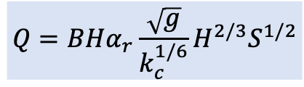

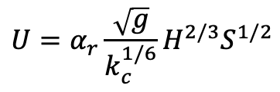
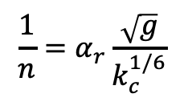
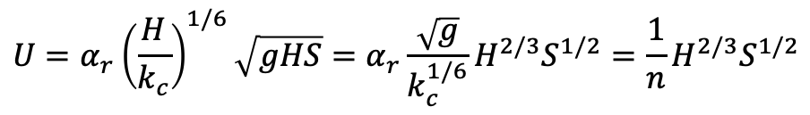
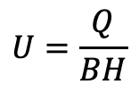
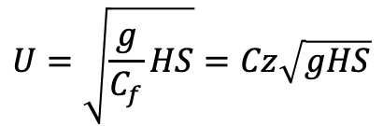
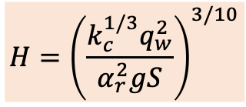
Chezy and Manning-Strickler formulations
How does our generalized Chezy relation change if we express the friction coefficient C_{f} as a function of the water depth and roughness height (slide 9)?
$$Cz=\frac{1}{\sqrt{C_{f}}}=α_{r}{\left(\frac{H}{k_{c}}\right)}^{1/6}$$
$$U=\sqrt{\frac{g}{C_{f}}HS}=Cz\sqrt{gHS}$$
Substituting the above equation in the generalized Chezy formulation
it is found that
$$U=α_{r}{\left(\frac{H}{k_{c}}\right)}^{1/6}\sqrt{gHS}=α_{r}\frac{\sqrt{g}}{k_{c}^{1/6}}H^{2/3}S^{1/2}=\frac{1}{n}H^{2/3}S^{1/2}$$
Manning-Strickler formulation with
$$\frac{1}{n}=α_{r}\frac{\sqrt{g}}{k_{c}^{1/6}}$$
With the aid of the continuity equation, a relation linking flow rate, channel width, bed slope and water depth is found
$$U=α_{r}\frac{\sqrt{g}}{k_{c}^{1/6}}H^{2/3}S^{1/2}$$
$$Q=BHα_{r}\frac{\sqrt{g}}{k_{c}^{1/6}}H^{2/3}S^{1/2}$$
$$H={\left(\frac{k_{c}^{1/3}q_{w}^{2}}{α_{r}^{2}gS}\right)}^{3/10}$$
$$U=\frac{Q}{BH}$$

Slide 22

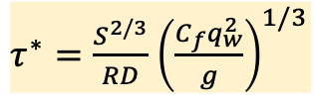
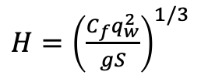


The Shields number, a non-dimensional bed shear stress
Bedload transport is estimated with empirical relations, which are not derived from first principles such as the conservation of mass, energy or momentum.
Field observations and measurements, as well as laboratory experiments, have shown that the bed shear stress is an important parameter for the prediction of bedload transport rates.
Empirical relations are generally expressed in non-dimensional form. A key non-dimensional parameter to quantify bedload transport and sediment mobility is the Shields number τ* defined as
$τ^{∗}=\frac{τ_{b}}{ρRgD}$
If the flow can be approximated a steady and uniform (normal) and
$$τ_{b}=ρgHS$$
$τ^{∗}=\frac{ρgHS}{ρRgD}=\frac{HS}{RD}$
If we use the generalized Chezy formulation
Shields number as a function of flow rate per unit width and slope, parameters readily available in most cases
$H={\left(\frac{C_{f}q_{w}^{2}}{gS}\right)}^{1/3}$
$τ^{∗}=\frac{S^{2/3}}{RD}$ ${\left(\frac{C_{f}q_{w}^{2}}{g}\right)}^{1/3}$
and

Slide 23
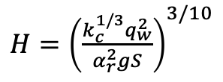
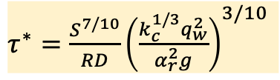

The Shields number, a non-dimensional bed shear stress
Bedload transport is estimated with empirical relations, which are not derived from first principles such as the conservation of mass, energy or momentum.
Field observations and measurements, as well as laboratory experiments, have shown that the bed shear stress is an important parameter for the prediction of bedload transport rates.
Empirical relations are generally expressed in non-dimensional form. A key non-dimensional parameter to quantify bedload transport and sediment mobility is the Shields number τ* defined as
$τ^{∗}=\frac{τ_{b}}{ρRgD}$
If the flow can be approximated a steady and uniform (normal) and
$$τ_{b}=ρgHS$$
$τ^{∗}=\frac{ρgHS}{ρRgD}=\frac{HS}{RD}$
If we use a Manning-Strickler formulation
Shields number as a function of flow rate per unit width and slope, parameters readily available in most cases
$H={\left(\frac{k_{c}^{1/3}q_{w}^{2}}{α_{r}^{2}gS}\right)}^{3/10}$
and
$τ^{∗}=\frac{S^{7/10}}{RD}{\left(\frac{k_{c}^{1/3}q_{w}^{2}}{α_{r}^{2}g}\right)}^{3/10}$

Slide 24
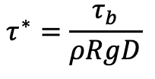
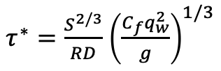
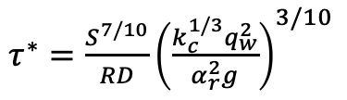
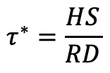
The Shields number, a non-dimensional bed shear stress
We found different relations to compute the Shields number for a given channel slope, width and discharge.
$$τ^{∗}=\frac{τ_{b}}{ρRgD}$$
$$τ^{∗}=\frac{HS}{RD}$$
$τ^{∗}=\frac{S^{2/3}}{RD}$ ${\left(\frac{C_{f}q_{w}^{2}}{g}\right)}^{1/3}$
$τ^{∗}=\frac{S^{7/10}}{RD}{\left(\frac{k_{c}^{1/3}q_{w}^{2}}{α_{r}^{2}g}\right)}^{3/10}$
Which diameter should we use?

Slide 25
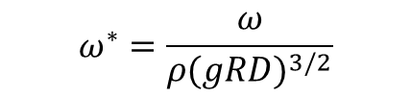
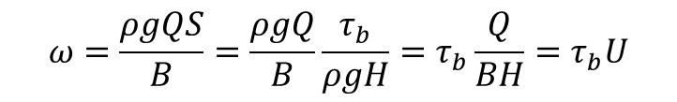


More on the unit stream power
We defined the unit stream power as
$$ω=\frac{ρgQS}{B}=\frac{water density×gravity×flow discharge×bed slope}{width}$$
$$S=\frac{τ_{b}}{ρgH}$$
At normal flow or equivalently
$$τ_{b}=ρgHS$$
Substituting the above equation in the definition of unit stream power, it is found that
$$ω=\frac{ρgQS}{B}=\frac{ρgQ}{B}\frac{τ_{b}}{ρgH}=τ_{b}\frac{Q}{BH}=τ_{b}U$$
The non-dimensional unit stream power is defined as
$$ω^{∗}=\frac{ω}{ρ{(gRD)}^{3/2}}$$

Slide 26
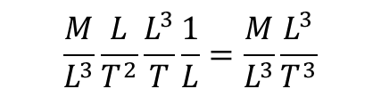
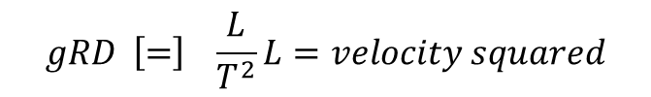
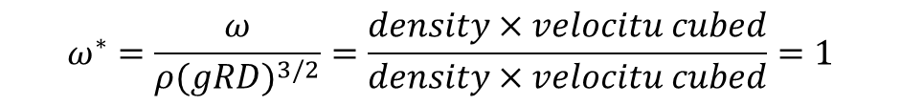
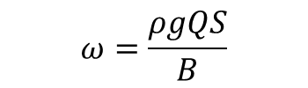
More on the unit stream power
We defined the unit stream power as
$$ω=\frac{ρgQS}{B}=\frac{water density×gravity×flow discharge×bed slope}{width}$$
$$S=\frac{τ_{b}}{ρgH}$$
At normal flow or equivalently
$$τ_{b}=ρgHS$$
Substituting the above equation in the definition of unit stream power, it is found that
$$ω=\frac{ρgQS}{B}=\frac{ρgQ}{B}\frac{τ_{b}}{ρgH}=τ_{b}\frac{Q}{BH}=τ_{b}U$$
$$ω=\frac{ρgQS}{B}$$
Dimension check
$$\frac{M}{L^{3}}\frac{L}{T^{2}}\frac{L^{3}}{T}\frac{1}{L}=\frac{M}{L^{3}}\frac{L^{3}}{T^{3}}$$
The non-dimensional unit stream power is defined as
$$ω^{∗}=\frac{ω}{ρ{(gRD)}^{3/2}}$$
$$gRD \left[=\right] \frac{L}{T^{2}}L=velocity squared$$
$$ω^{∗}=\frac{ω}{ρ{(gRD)}^{3/2}}=\frac{density×velocitu cubed}{density×velocitu cubed}=1$$

